Slide 1


Slide 2
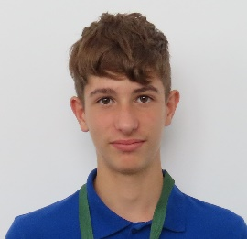
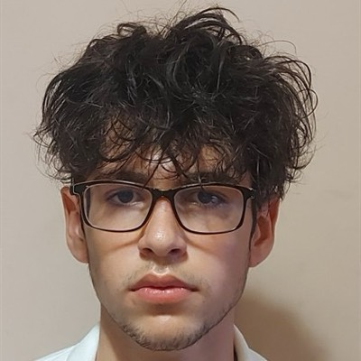
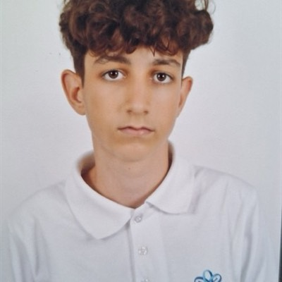
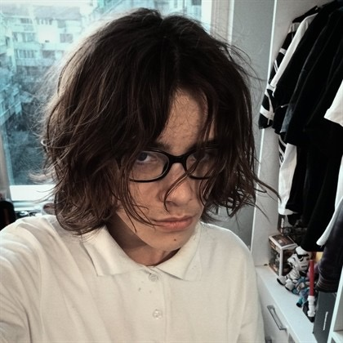
Our team
Pavel Plamenov Parvanov
Scrum Trainer
Yavor Velizarov Velizarov
Back-end Developer
Bozhidar Hristov Stoyanov
Back-end Developer
Desislav Dimitrov Aleksandrov
Designer

Slide 3
About our program
Test Administration:
Users can take tests on different subjects, such as History, Geography, Biology, Math, and Informatics.
Performance Metrics:
Average Result
Best Result
Worst Result
Average Time
Best Time
Worst Time
Category Breakdown:
Average Score
Best Score
Worst Score
Best/Worst Users

Slide 4
Stages
Stage 1
Stage 2
Stage 3
1st week
2st week
3st week
We were thinking about our logo and what site should we make.
We were organize meetings and we started working on the project.
We finished the project and made a presentation and documentation.

Slide 5






Used Technologies

Slide 6
Thank You!
Let’s get to the app…

